Slide 1


Shoot the Zombie
With AI

Slide 2
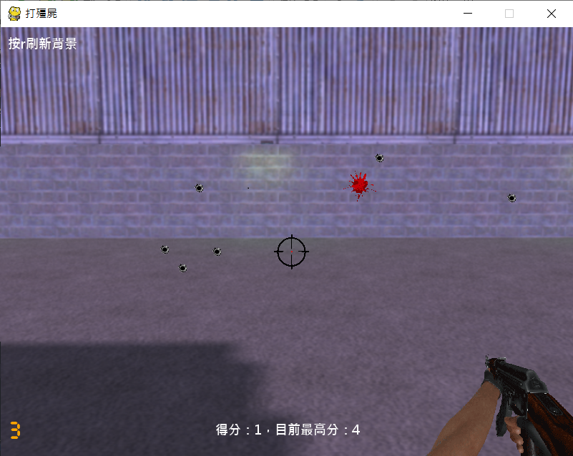
Game screen
Key Description/Status
Hit
Zombie
shoot it
Crosshair
Missed
Remaining ammo
Score/Highest score

Slide 3
Game Version
Playable version
GA version
PSO version
PSO_Mutaion version
PSO version 2
TensorFlow version
TensorFlow version 2

Slide 4
Let’s see how it work

